Slide 1
UML
(Unified Modeling Language)

Slide 2
1. UML (Unified Modeling Language)
The UML is a standard language for specifying, visualizing, constructing and documenting the artifact (work of art/objects) of software systems as well as for business modeling and other non- software systems.
The UML is a very important part of developing object oriented software and the software development process.
UML provides a set of notation (rectangle, lines, ellipse etc) to create models of system.
UMLs also facilitate the generation of analysis and design procedure themselves.

Slide 3
Before using UML, it is important to clearly understand what exactly is meant by a model, why is it necessary to create a model.
It is a graphical model tools, are very popular because they are easy to understand and construct.
About Modeling: is a proven and well-accepted engineering techniques.
Modeling is a architectural artifact which helps to users visualize the final product.

Slide 4
The UML Language for Documenting
A healthy Software Organization produces all sorts of artifacts in addition to raw executable code. These artifacts/objects includes:
  Requirements
  Architecture
  Design
  Source code
  Project Plan
  Tests
  Prototypes
  Releases

Slide 5
Where can the UML be used?
The UML is not limited to modeling software.
Enterprise information systems
Banking and financial services
Telecommunications
Transportation
Defense/aerospace
Retail
Medical electronic
Scientific
Distributed web-based services

Slide 6
Building Blocks of the UML
The UML encompasses three kinds of building blocks:
  Things (Structural, Behavioral, Grouping & Annotational things)
  Relationships (Dependency, Association, Generalization and Realization relationships)
  Diagrams (Use Case, Class, Object, Sequence, Collaboration, Activity, Component & Deployment diagrams)
  Things are the abstractions that are first class citizens in a model;
  Relationships ties these things together;
  Diagrams group interesting collections of things.

Slide 7
Common Mechanism in the UML
UML is made simpler by the presence of four common mechanisms that apply consistently throughout the language:
  Specifications – every part of graphical notation there is a specification that provides the textual statements of the syntax and semantics of that building block.
  Adornments (decoration) – have a unique & direct graphical notation that provides a visual representation of the most important aspects of the element.
  Common divisions – in modeling OOS, the world gets divided in at least a couple of ways.
  Extensively - provide standard language writing the S/W blueprints, to extend the language in controlled ways

Slide 8
2. Why construct a model?
An important reason behind constructing a model is that it helps manage complexity.
Once the models of a system have been constructed, these can be use for a variety of purpose during software development, including the following:
    Visualize & understand the problem & the working of a system
    Analysis
    Specification
    Design
    Code generation
    Testing

Slide 9
3. UML Diagram:
UML can be used to construct nine different types of diagrams to capture different views of a system.
For example, a building can be modeled from several views : ventilation perspective, electrical perspective, lighting perspective etc.
So, UML diagram provide different perspective of the S/W system to be developed and facilitate a comprehensive understanding of the system.
The UML diagram can capture the following views of a system.
  Structure view, Behavioral view, Implementation view, Environmental view.

Slide 10
UML Diagram:
Structure View
Class diagram
Object diagram
Behavioral View
Sequence diagram
Collaboration
State-chart
activity
User View
-use case diagram
Environmental View
Deployment Diagram
Implementation View
component diagram

Slide 11
User View
This view defines the functionalities (facilities) made available by the system to its user. (displays the relationship among actor & use case.)
The users’ view capture the external users’ view of the system in terms of the functionalities offered by the system.
Structured View
It defines the kinds of objects (classes).
It is important to the understanding of the working of a system and to its implementation. Capture the relationships among the classes.

Slide 12
Behavioral View (sequence, collaboration, activity)
This view capture how objects interact with each other to realize the system behavior.
The system behavior capture the time- dependent behavior of the system. It is called Interaction diagram.
Implementation View (Component Diagram)
This view capture the important components of the system and their dependencies.
Environmental View ( Deployment Diagram)
This view models how the different components of the system and their dependencies are setup and organize.

Slide 13
4. Type of UML Diagram
Use Case Diagram: displays the relationship among actor & use case (interactions).
Class Diagram: model class structure and contents using design elements such as classes, packages and objects.
Display relationships (associations to each other)
Sequence Diagram: displays the time sequence of the objects participating in the interaction.
Vertical dimension is time & horizontal dimension is different objects.
Collaboration Diagram: displays an interaction organized around the objects and their links to another.

Slide 14
Activity Diagram:
  displays a special states diagram where most of the states are action states and
  Most of the transitions are triggered by completion of the action in the source states.
  So, this diagram focused on flows driven by internal processing.
Component Diagram:
  Displays the high level packaged structure of the code itself.
  Dependencies among components are shown, including source code components, binary code components & executable components.
Deployment Diagram:
  Displays the configuration of run-time processing elements and the software components, processes and objects that live on them.

Slide 15
USE CASE DIAGRAM
A use case is a set of scenarios that describing an interaction between a users and a system.
A use case is a technique used to describes what a new system should do or what an existing system already does from the user’s point of view..
An important aim of use case is to describe the functional requirements of the system
The functional of the system is represented by a complete set of use cases. (system used by users)
A use case diagram shows the relationship between actors and user case in a system.
The two main components of a use case diagram are use case and actors

Slide 16
When to Use: Use Cases Diagrams
Use cases are used in almost every project.
They are helpful in exposing requirements and planning the project.
During the initial stage of a project most use cases should be defined, but as the project continues more might become visible.

Slide 17
Use case diagrams depict (describe):
Use cases. A use case describes a sequence of actions that provide something of measurable value to an actor and is drawn as a horizontal ellipse.
Actors. An actor is a person, organization, or external system that plays a role in one or more interactions with your system. Actors are drawn as stick figures.
Associations. Associations between actors and use cases are indicated in use case diagrams by solid lines.
System boundary boxes. You can draw a rectangle around the use cases, called the system boundary box, to indicates the scope of your system. Anything within the box represents functionality that is in scope and anything outside the box is not.

Slide 18
We can use following components:
  System Boundary
  Actors
  Use Cases
  Relationship between
  actors and use cases
Browse book
catalogue
Located Book by
Title or author
Use Case
Customer
Request
Unlisted book
Actor

Slide 19
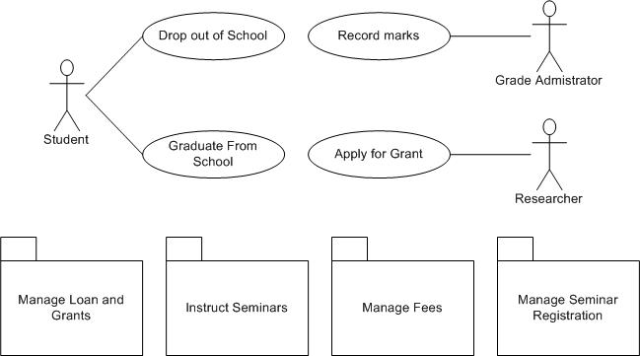
Example of Use case diagram

Slide 20
An actor is represents a user or another system that will interact with the system you are modeling.
A use case is an external view of the system that represents some action the user might perform in order to complete a task.
Use cases are used in almost every project, helpful in exposing requirements and planning the project.

Slide 21
issue_ book
query_book
Librarian
Return_book
Student
Create_member
Library Information System
add_book

Slide 22
Supermarket Prize Scheme
Use cases are:
  register customer
  register sale
  evaluate register customer and sale
  select winner

Slide 23
Supermarket Prize Scheme
Register_customer
U1
<<include>>
Register_sales
U2
Customer
Clerk
<<include>>
Evaluate customer
and sales U3
Relationships represented using a predefined stereotype <<incluede>>
Select-winner
U4
Sales Clerk
Supermarket Prize Scheme
Manager

Slide 24
U1: The customer can register himself by providing necessary details.
        Select register customer option
        Display the prompt
        Enter the necessary values (ID)
        Registered
U2: The clerk can register the details of the purchase made by a customer.
        Select register sales details
        Enter the necessary values (ID)
        Registered sales details
U3/U4: The manager can evaluate and generate the winner list.
        Evaluate customer and details sales
        Select the winner list

Slide 25
Account
query balance
print balance sheet
receive grant
make payment
Academic
enroll student
compute CGPA
enter grade
modify grade
print grade card

Slide 26
Function of Library Management System (LIS)
issue_book
renew_book
check_reservation
get_user_selection
update_selected_books
issue_book
renew_book
<<include>>
<<include>>
<<include>>
<<include>>
check_reservation
get_user_selection
update_selected_
books

Slide 27
Exercise of Use case
Use Case element as follows:
  Customer to Deposit Cash at ATM
  Customer to Apply for Loan
  Bank Teller to Withdraw Money
  Bank Teller to Deposit Money
  Bank Computer to Update Customer Database
  Technician to Service ATMs
  Loan Officer to Process a Loan

Slide 28
Actor elements as follows:
  Employees
  Bank Teller
  Loan Officer
  Technician
  Bank Computer
Use Case elements (interactions) as follows:
  Deposit Money
  Process a Loan
  Apply for Loan
  Deposit Cash at ATM
  Service ATMs
  Update Customer Database

Slide 29
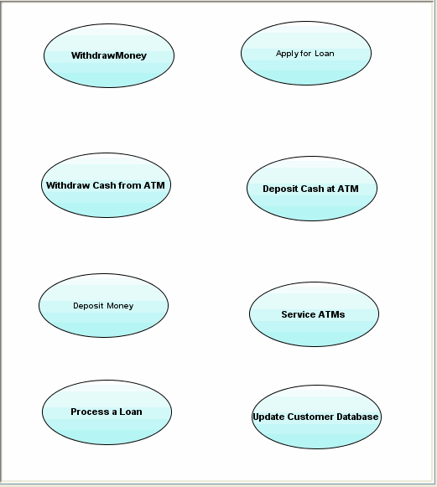

Slide 30
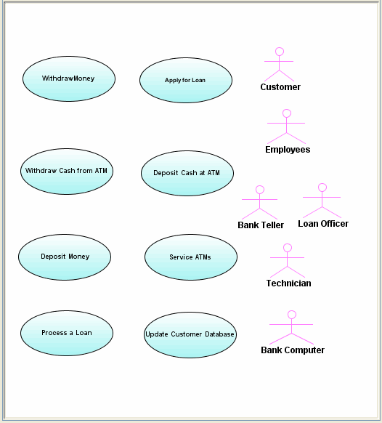

Slide 31
Class
An object is any person, place, thing, concept, event, screen, or report applicable to your system. Objects both know things (they have attributes) and they do things (they have methods).
A class is a representation of an object and, in many ways, it is simply a template from which objects are created.
Classes form the main building blocks of an object-oriented application.
Although thousands of students attend the university, you would only model one class, called Student, which would represent the entire collection of students.

Slide 32
Responsibilities:
Classes are typically modeled as rectangles with three sections: the top section for the name of the class, the middle section for the attributes of the class, and the bottom section for the methods of the class.
For example, students have student numbers, names, addresses, and phone numbers. Those are all examples of the attributes of a student. Students also enroll in courses, drop courses, and request transcripts.

Slide 33
Class Responsibility Collaborator (CRC) model
A CRC model is a collection of standard index cards that have been divided into three sections because a class represents a collection of similar objects, a responsibility is something that knows or does.
And a collaborator is another class that a class interact with to fulfill its responsibilities.
So how do you create CRC models? Iteratively perform the following steps:
  Find Classes
  Find Responsibilities
  Define Collaborators (collaborates to other classes)

Slide 34
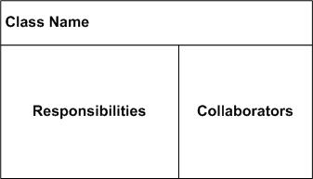
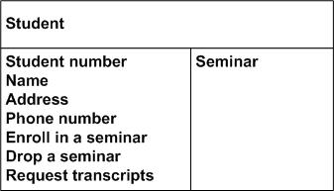
CRC Card Layout

Slide 35
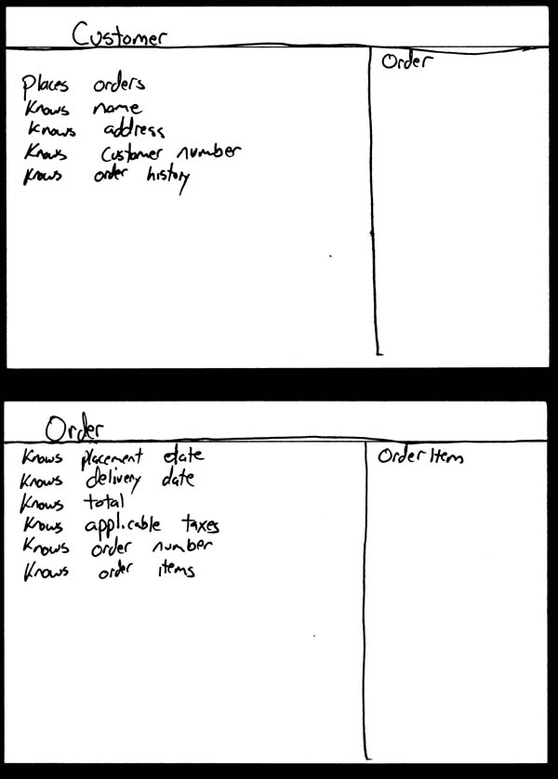
Hand-drawn CRC Cards.

Slide 36
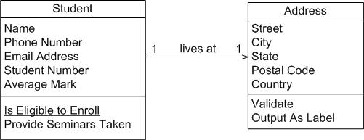
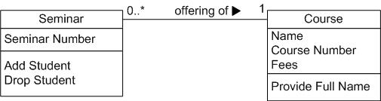
Student and address (Conceptual class diagram).
Seminar normalized (Conceptual class diagram).

Slide 37
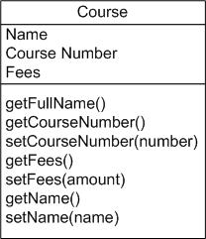
Course with accessor methods (Inching towards a design class diagram).

Slide 38
Associations
  Objects are often associated with, or related to, other objects.
  Notation for associations.

Slide 39
An association represents a relationships between classes.
An association can have many names with the direction shown by a small solid triangle either preceding or following the name.
Association between person and Flat – the association named ‘owns’ from class Person to class Flat & the association named ‘ownedBy’ from class Person.
1..*
Person
owns
1..*
Flat
ownedBy

Slide 40
Unidirectional association between Person and Flat – the unidirectional association between class Person & class Flat.
Here, 1..* indicates one or many, whereas * or 0..* indicate zero or many.
This indicator is called multiplicity
1..*
Person
owns
*
Flat

Slide 41
1. One-to-One Association
Suppose a person owns a flat which shown in given figure.
One-to-One unidirectional association between the class Person & the class Flat.
Converting to the following Java classes, we obtain:
public class Person {
public Flat owns; }
public class Flat {
public Person ownedBy:
}
1
Person
owns
1
Flat

Slide 42
1. One-to-Many Association
Suppose a person own many flat which shown in given figure.
One-to-Many bidirectional association between the class Person & the class Flat.
Converting to the following Java classes, we obtain:
public class Person {
public Collection owns; }
public class Flat {
public Person ownedBy;
}
1
Person
owns
*
Flat

Slide 43
In this case, in the class Person, there will be a reference to a collection of objects of the class Flat, and in the class Flat, there will be a reference to the class Person.

Slide 44
1. Many-to-Many Association
Suppose a person can own many flat and a flat can be owned by many persons.
There will be a reference to a collection of persons in the class Flat and a reference to a collection of flats in the class Person.
Converting to the following Java classes, we obtain:
import java.util.*;
public class Person {
public Collection owns; }
import java.util.*;
public class Flat {
public Person ownedBy;}
*
Person
owns
*
Flat
ownedBy

Slide 45
MyClass
MyClass
In the first diagram, the remaining two compartments are for attributes and operations which have not yet been filled).
The first character of class name should be written in capital letter.
In second figure identify only class. No depict attributes and functional part.

Slide 46
Class Diagram:
So, A class diagram is a static model that defines the system’s legal object configurations.
Any objects that exit during the system’s execution must be instances of classes in the class diagram and
Any relationships between those objects must be instances of associations between those object’s classes.
So, a class diagram, therefore a key component of an object-oriented design.

Slide 47
Class diagrams are widely to describe the types of objects in a system and their relationships.
Classes are composed of three things: a name, attributes, and operations.
Class diagram are used in nearly all object oriented software designs.
It is used to describes the classes of the system and their relationships to each other.
A class have optimal attributes and operation components.

Slide 48
Attribute and Operations:
An attribute represents some property of an object.
Attribute is used to includes the value of an object.
The attributes of the class have their property which are used to placed the values.
The attributes of the class Employee are empName, empId, deptName, dateOfJoining etc.
There are some attributes read only, i.e., they are only gettable, they cannot be assigned values.

Slide 49
For example the ‘area ‘ is a read only attribute.
The function calculateArea() calculates the area using a fixed formula.
Triangle
Base:float
Height:float
/area:float
setBase():void
getBase():float
setHeight():void
getHeight():float
calculateArea():void
getArea():float

Slide 50
Associations Class:
Consider the relationship ‘person rents flat’.
To rent a flat, often a contract is required.
Now the details of the rent, such as the amount, and mode of payment of rent are neither the property of the class Person nor the property of the class Flat.
It is a property of the association ‘rents’.
So, an association class called ‘Rent’ can be made and the properties of rent can be included in it.
The association class is a class that is connected to the association of two classes using a dashed line.

Slide 51
Rent
Person
Flat
The association Rent between class Person and class Flat being promoted to an association class.

Slide 52
Ternary Associations Class:
Consider the case of buying reference books for a college library.
The total bill depends on three factors: the publisher, the quantity of books, and the price of each book.
Three classes are created, namely, Publisher, BookPrice, and PurchasedQuantity and the ternary association that exists between them.
This will assist us finding the total bill.
The ternary association is represented by a hollow diamond .

Slide 53
TotalBill
*
*
Publisher
*
BookPrice
*
FlatPurchasedQty
The ternary association is represented by a hollow diamond .

Slide 54
Recursive Associations Class:
A class may have an association on itself.
This association is called recursive (reflexive) association.
For example, one Person (Mother) can give birth to other persons (Child).
At one end the person plays the role of a Mother and at the other end that of a child.
1
givesBirthTo
Person
Mother
*
child

Slide 55
Example of Class Diagram:
Customer
Class Name
name: String
Address: string
Attributes
creditRating()
Operations
Example of class diagram association:
Association
Order
Customer
Date received: date
Is prepaid: boolean
Number: string
Price: money
n
1
Name: string
Address: string
Dispatch()
Close()
Multiplicity
creditRating()
Many_valued
Mandatory

Slide 56
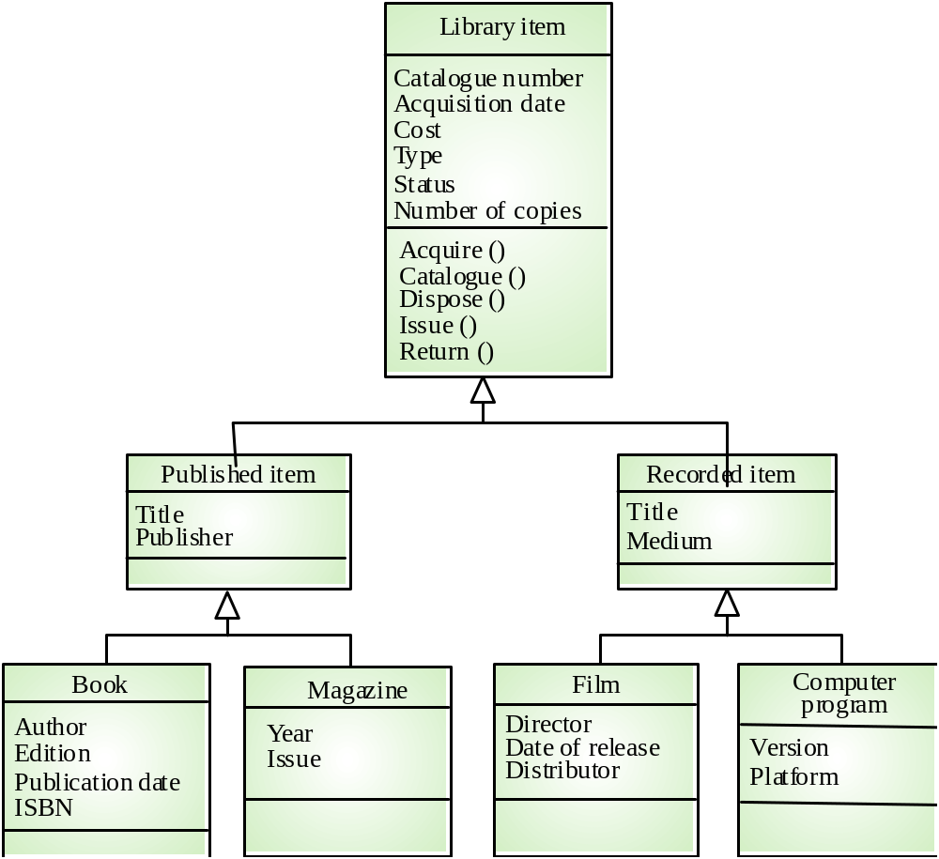
Library class hierarchy

Slide 57
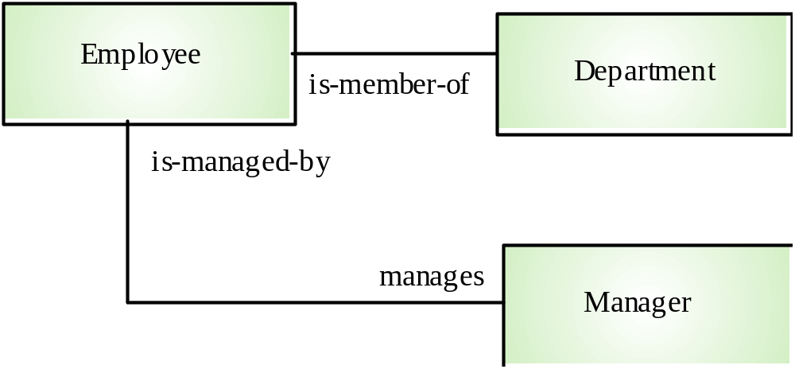
An association model

Slide 58
INTERACTION DIAGRAM
An interaction diagram is a graphical representation of how object interact with one another in a scenario.
Interaction diagram are used to illustrate the dynamic behavior of a community of objects that collaborate by passing messages in order to perform a certain task.
An interaction diagram depicts only the communication between objects.
Objects communicate in an interaction diagram by sending messages.
A message may carry data with it.
Use cases have basic and alternate flows.

Slide 59
Each flow could be shown in an interaction diagram.
So, use case list the behavior and sequence diagram can designate the way objects collaborate to implement the behavior.
For example:
  Telephone Agent object might send an order object a cancellineItem message with the data value 22327(item number).

Slide 60
For example:
  Consider the successful scenario of the ‘withdraw cash’ use case.
  Customer inserts a card in the ATM machine.
  The machine prompts him for a pin.
  Customer enter the pin.
  The machine authenticates the pin, and asks the user to enter the amount that customer wants to withdraw.
  After enter the amount: the machine verifies that at least Rs. 500 will be left as balance in saving account if the amount requested by the customer is given.
  It then generates the cash, displays the balance in the saving account, and outputs the card.

Slide 61
  (Class: customer, ATM and server and depict the association between them)
UML provides a rich notation in its interaction diagram to depict a variety of circumstance.
So, UML provides two types of interaction diagram (the object-interaction diagram comes in two styles).
1. the sequence diagram – is organized temporally with the focus on the order in which messages are sent between objects.
2. the collaboration diagram – is spatially oriented with an emphasis on the links between objects.
So, an interaction is a behavior that comprises a set of messages exchanged among a set of objects within a context to accomplish a purpose.

Slide 62
A message is a specification of a communication between objects that conveys information with the expectation that activity will ensue (proceed).
Message = is the specification of a communication among objects that conveys information.
Sequencing = when an object passes a message to another object, the receiving object might in turn send a message to another object, which might send a message to yet a different object and so on.

Slide 63
Sequence Diagram:
are the first type of interaction diagram.
Show the interaction between objects as they collaborate to realize scenarios within a use case.
Show the sequence of messages which objects pass among each other, and
The interaction is shown over time which is read from top to bottom

Slide 64
Sequence diagram demonstrate the behavior of objects in a use case by describing the objects and the message they pass.
The diagrams are read left to right and describing.
Example.
Object:class1
Object:class2
Object:class3
message1()
message2()
return()
return()
This diagram shows an object of class1 start the behavior by sending message to an object class2.
Message pass between the different objects until the object of class1 receives the final message.

Slide 65
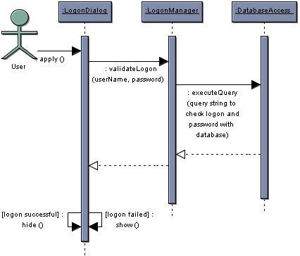
An example sequence diagram for our logon collaboration is shown:

Slide 66
Things to Note:
The flow of time is shown from top to bottom, that is messages higher on the diagram happen before those lower down
The blue boxes are instances of the represented classes, and the vertical bars below are timelines
The arrows (links) are messages - operation calls and returns from operations
The hide and show messages use guards to determine which to call.
Guards are always shown in square braces [ ] and represent constraints on the message (the message is sent only if the constraint is satisfied)

Slide 67
The messages are labelled with the operation being called and parameters are shown.
You can choose to enter the parameters or not - this is dependent upon their importance to the collaboration being shown
The sequence numbers are not shown on the messages as the sequence is intrinsic to the diagram

Slide 68
Message and their notation
  Suppose an object of class A sends a message msg1() to the object of class B.
  If the first object does not have to wait for the return, then
  The message asynchronous, i.e. the object of class A can msg2() to object of class C.
Example:
(username,password)
:validate logon
logonDialog
logonManager
databaseAccess
apply()
:executeQuery
(to check logon & password with database
user
Logon failed show()

Slide 69
Simple System Sequence Diagram
An object (underlined) representing the automated system
The actor interacting with the system
:System
An input message
Clerk
InquireOnItem(catlogID,prodID,size)
The object lifeline. Shows the sequence of messages, top to bottom
Item information
An output message

Slide 70
Each message is labeled with the message name.
Some control information can also be included.
  A condition (e.g. [invalid]) indicate that a message is sent, only if the condition is true.
  An iteration marker(*) shows that the message is sent many time to multiple receiver objects, as would happen when you are iterating over a collection or the elements of an array. (for every book object).
Library
book issue
control
library book
register
library book
library member
issued book
Find member borrowing
[invalid]
Display member borrowing
select book
book selected
find *
issued book
issued book

Slide 71
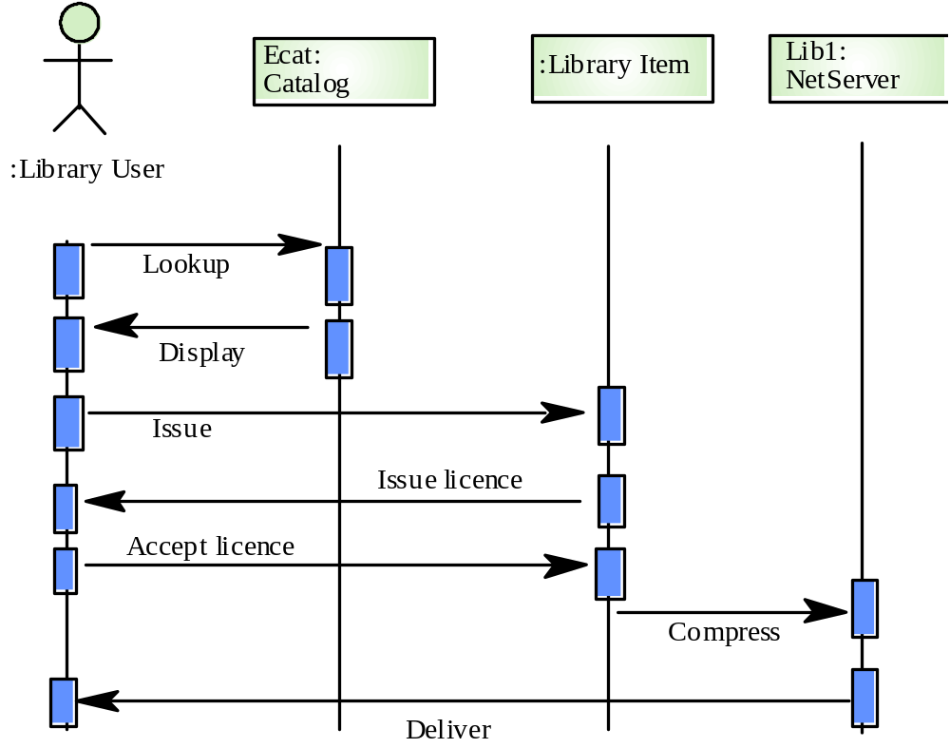
Issue of electronic items

Slide 72
Assignment of ATM System
Develop:
System Startup Sequence Diagram
Session Sequence Diagram
Transaction Sequence Diagram
System Shutdown Sequence Diagram

Slide 73
Collaboration Diagram:
Collaboration diagrams shows the relationship between object and the order of messages passed between them.
So, it shows the structured and behavioral aspects explicitly.
The object are listed as icons and arrows indicate the messages being passed between them.
There are many acceptable sequence numbering schemes in UML.
For Example.
Object:class1
1: message()
Object:class2
Object:class3
:order entry window
2: message()
1: prepare()
:order
:delivery item
2: new()
[in stock]

Slide 74
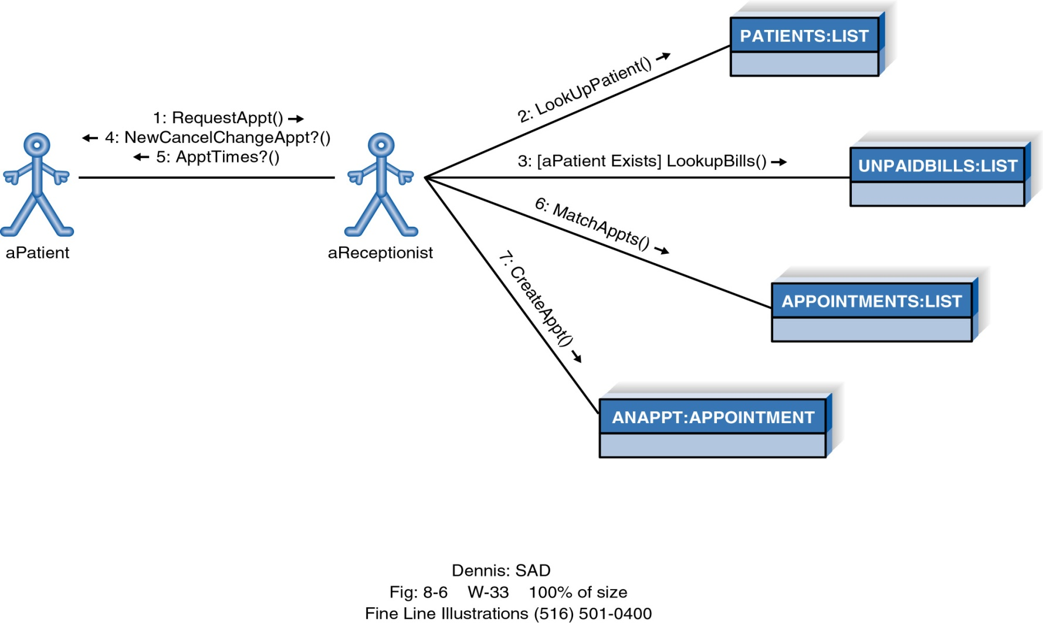
Example Collaboration Diagram

Slide 75
Second example of collaboration diagrams
Library book
register
book
9:find*
9: issued book
4: confirm
6: book select
1: enter issue book
7: reserved
library
issue book
3: display mem. borrower
5: select book
2: find member borrowing
8: confirm
Library
member

Slide 76
State Transition Diagram
State diagram are used to describe the behavior of a system.
Describe all of the possible states of an abject as events occur.
Each diagram usually represents objects of a single class and track the different states of its objects through the system.
State diagram have very few elements.
The basic elements are rounded boxes or box representing the object and
Arrows indicating the transition to the next state.

Slide 77
State Transition Diagram
Initial state
State Name
Activity
Do/action
Transition

Slide 78
State Transition Diagram
All items available
Checking
Dispatching
Do/check time
Do/initiate delivery

Slide 79
Activity Diagram
Activity diagrams describe the workflow behavior of a system.
Activity diagrams are similar to state diagram because activities are the state of doing something.
The main reason to use activity diagram is to model the workflow behind the system being designed.
Activity diagram shows the flow of activities through the system.
A fork is used when multiple activities are occurring at the same time.

Slide 80
Commonly contains:
  Activity state & Action state
  Transition
  Objects
The following diagram are reads from top to bottom and have braches and forks to describe conditions and parallel activities.
Which is used when multiple activities are occurring at the same time.
Below display activity diagrams describe the workflow behavior of a system.

Slide 81
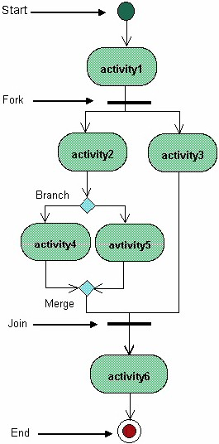
- This diagram shows a fork after activity1.
- This indicates that both activity2 & activity3 are occurring at the same time.

Slide 82
-After activity2 there is a branch.
The branch describes what activities will take place based on a set of conditions.

Slide 83
This diagram shows the workflow of a system:
Release work order
[Materials not ready]
branch
Reschedule
[Materials ready]
Assign tasks

Slide 84
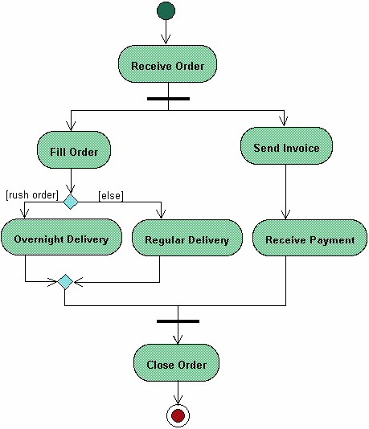
Example of an activity diagram for processing order

Slide 85
Elements of an Activity diagram
An activity diagram consists of the following behavioral elements:

Slide 86




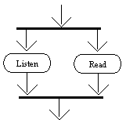

Element and its description | Symbol
Initial Activity: This shows the starting point or first activity of the flow. Denoted by a solid circle. This is similar to the notation used for Initial State.
Activity: Represented by a rectangle with rounded (almost oval) edges.
Decisions: Similar to flowcharts, a logic where a decision is to be made is depicted by a diamond, with the options written on either sides of the arrows emerging from the diamond, within box brackets.
Signal: When an activity sends or receives a message, that activity is called a signal. Signals are of two types: Input signal (Message receiving activity) shown by a concave polygon and Output signal (Message sending activity) shown by a convex polygon.
Concurrent Activities: Some activities occur simultaneously or in parallel. Such activities are called concurrent activities. For example, listening to the lecturer and looking at the blackboard is a parallel activity. This is represented by a horizontal split (thick dark line) and the two concurrent activities next to each other, and the horizontal line again to show the end of the parallel activity.
Final Activity: The end of the Activity diagram is shown by a bull's eye symbol, also called as a final activity.

Slide 87
The Physical World
(Implementation View)
Component diagrams illustrate the organizations and dependencies among software components
A component may be
  A source code component
  A run time components or
  An executable component
Notes:
39

Slide 88
Component Diagram
Illustrate the piece of software, embedded controller, etc. that will make up a system.
A component diagram has a higher level of abstraction than Class diagram – usually a component is implemented by one or more classes (pr objects) at runtime.
They are building blocks so a component can eventually encompass a large portion of a system.
Notes:
39

Slide 89
Component Diagram
Billing.exe
Register.exe
Billing
System
People.dll
Course.dll
User
Course
Student
Professor
Course
Course
Offering
Notes:
40

Slide 90
Product
Item code
Order
customer
Customer details
Account details
Account
This diagram demonstrates some components and their inter-relationships.
Assembly connectors “link” the provided interface supplied by Product and Customer to the required interface which is specified by Order.
A dependency relationship maps a customer’s associated account details to the required interface; Payment, which is indicated by Order.
Notes:
39

Slide 91
Exercise:
  Order, Item, Inventory-Item, Customer and Account are the objects or components.
  Using this components, develop a component diagram.
Exercise:
  Course, Course-Section, Student and Course-Enrollment are the components.
  Develop a component diagram using the above components.
Notes:
39

Slide 92
Deploying the System
(Environmental View)
The deployment diagram shows the configuration of run-time processing elements and the software processes living on them
The deployment diagram visualizes the distribution of components across the enterprise.
It shows the configuration of the hardware elements (nodes) and shows how software elements and artifacts are mapped onto those nodes.
Notes:
41

Slide 93
A node is either a hardware or software element. It is shown as a three-dimensional box shape.
Server
Node
Notes:
41

Slide 94
A node instance can be shown on a diagram. An instance can be distinguished from a node by the fact that its name is underlined and has a colon before its base node type.
The following diagram shows a named instance of a computer.
HP Pavilion:
Computer
Instance node
Notes:
41

Slide 95
Node Stereotypes
A number of standard sterotypes are provided for nodes, namely <<cdrom>>, <<computer>>, <<pc>>, <<pc client>>, <<pc server>>, <<server>>, <<storage>> and <<user pc>>.
These will display an appropriate icon in the top right corner of the node symbol.
Stereotype Nodes
PC
Client
CD-ROM
Storage
Device
Unix
Server
Security
Device
Notes:
41

Slide 96
Artifact
An artifact is a product of the Software Development process of SE.
That may include process model (use case model), source file, executable, design document, test report and user manuals etc.
An artifact is denoted by a rectangle showing the artifact name.
The <<artifact>> keyword and a document icon, as shown below:
<<artifact>>
main.c
Notes:
41

Slide 97
An example of Network Model
firewall
1
<<top-ip>>
1
Local Network
1
1
<<ethernet>>
<<ethernet>>
1
1..*
Primary
server
Work
station
Notes:
41

Slide 98
An example of Embedded Model
:Keyboard
1
1
<<connector>>
:Motherboard
:LCD Display
<<executable>>
app.exe
1
1
<<connector>>
This diagram shows a deployment diagram for part of an embedded system, depicting an executable artifact as being contained by the motherboard node.
Notes:
41

Slide 99
Deployment Diagram
Registration
Database
Main
Library
Building
Dorm
Notes:
42

Slide 100
Thank you

